Slide 1
OOPS 1
CLASSES AND OBJECTS: ENCAPSULATION 1
LECTURE 1
ANURADHA SAHU
SENIOR FACULTY

Slide 2
CLASSES
Group of objects.
Share common properties and methods.
class keyword followed by <class-name>
class names should start with capital letter.
Syntax:
class <class-name>
{
//body of the class
}

Slide 3
EXAMPLE:
//A simple class name student
class Student
{
String name;
int id;
}

Slide 4
ACTIVITY -1
Create a class named Employee.

Slide 5
class Employee
{
String name;
int salary;
}

Slide 6
ACTIVITY-2
Create a class named Person.

Slide 7
class Person
{
String name;
int id;
int salary;
}

Slide 8
ACTIVITY-3
Create a class named Vehicle.

Slide 9
class Vehicle
{
String type;
String model;
String color;
int tyres;
}

Slide 10
OBJECTS
Member of the JAVA class.
Each object has an
State: What the objects have: Student have first name, last name and age.
Behavior: What the objects do: Student attend the course JAVA.
Identity: What makes them unique: Student have student id number or an email which is unique.
An object is created using the “new” keyword.

Slide 11
SYNTAX AND EXAMPLE:
Syntax:
<class_name> object_name = new <class_name>();
Example:
Student st = new Student();

Slide 12
ACTIVITY-4
Create an object of the class Employee.
.

Slide 13
Employee e = new Employee();

Slide 14
ACTIVITY-5
Create an object of the class Person.

Slide 15
Person p = new Person();

Slide 16
ACTIVITY-6
Create an object of the class Vehicle

Slide 17
Vehicle v =new Vehicle();

Slide 18
CLASSES VS OBJECTS
CLASSES
OBJECTS
Template for creating objects.
It does not allocate memory space.
Declare class only once.
Instance of the class.
It allocates memory space.
It can create more than one objects.

Slide 19
WHAT IS AN INSTANCE?
The word “instance” is used
when referring to the specific object of a specific type.
But when talking about objects in general.
I would say “objects rather than “instance”.
For example:
Student st =new Student(); // instance of the class.

Slide 20
Class is where you define the state and behavior of your program using fields and methods.
Instance of class is assigning tasks to those fields and methods.
Object is creating and instance of class using object variable.

Slide 21
ENCAPSULATION
The process of wrapping up of the data members and methods in a single unit is called Encapsulation.
It help us to keep related fields and methods together which makes our code cleaner and easy to read.
Data Members
Methods
+
ENCAPSULATION

Slide 22
VIDEO LINK
For class and object:
https://youtube/7WhnYwoBY24
Is Java pure OOP language?
https://youtube/hvBOZQCvqac
Why we need OOP?
https://youtube/IcDKYxPH7zw

Slide 23
INTERVIEW QUESTIONS
What is JAVA and its features?
What is class and objects? Give an example.
What is OOPs?
Why do we need Oops?
Difference between JDK,JVM and JRE?
Difference between class and objects?
Why is JAVA platform independent language?
Why is JAVA not a pure object oriented language?
What do you mean by encapsulation? Why we need it?

Slide 24
Explain public static void main(String[] args).
What are the types of access modifiers?
Difference between reference variable , class variable ,object variable.

Slide 25
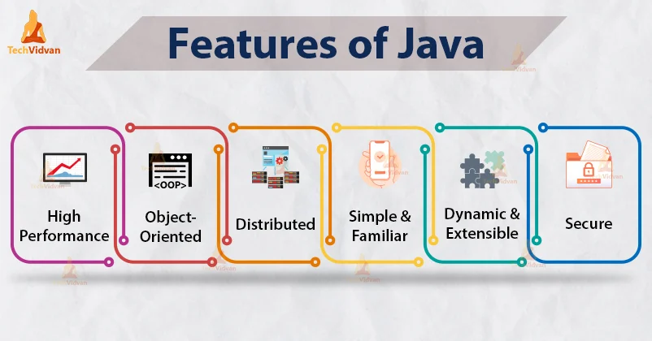
Answer slides
1) Java is widely used object-oriented programming language and software platform that runs on billion devices., including notebook computers,mobile devices, gaming consoles, medical devices. It was developed by James Gosling (Sun microsystem) in 1995 acquired by Oracle .
Features of Java:

Slide 26
2) Refer slide.
3) OOP stands for Object-Oriented Programming. Procedural programming is about writing procedures or methods that perform operations on the data, while object-oriented programming is about creating objects that contain both data and methods.
4) OOP helps to keep the Java code DRY "Don't Repeat Yourself", and makes the code easier to maintain, modify and debug. OOP makes it possible to create full reusable applications with less code and shorter development time.

Slide 27
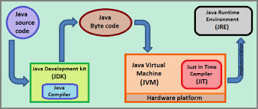
5)

Slide 28
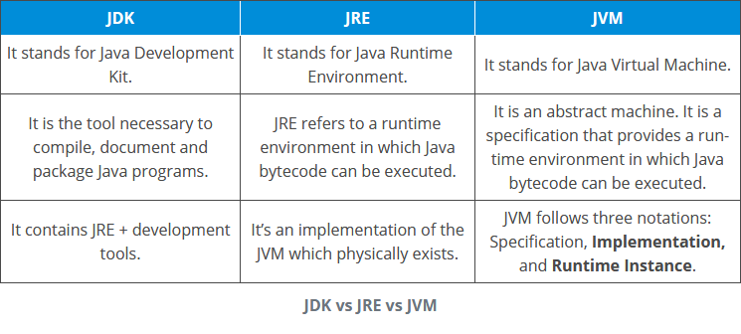

Slide 29
6)Refer slide
7) JVM stands for Java Virtual Machine, it performs many functions such as loading, verifying, and executing the Java bytecode. It is considered the core of Java programming. It makes the Java platform independent.
8)Refer link given in the slide.
9)Refer slides

Slide 30
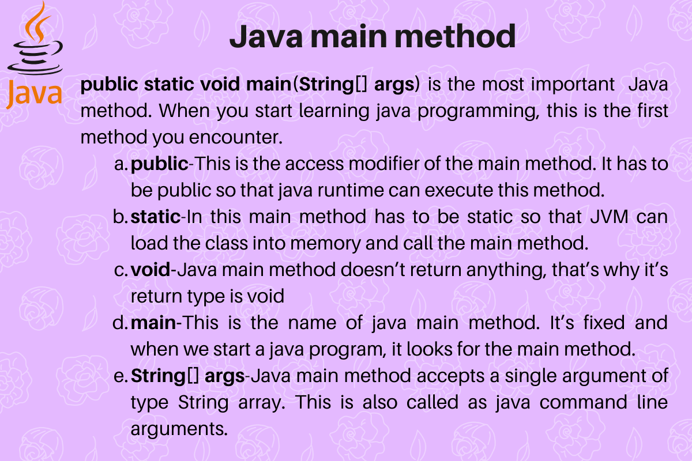

Slide 31
There are four types of Java access modifiers:
Private: The access level of a private modifier is only within the class. It cannot be accessed from outside the class.
Default: The access level of a default modifier is only within the package. It cannot be accessed from outside the package. If you do not specify any access level, it will be the default.
Protected: The access level of a protected modifier is within the package and outside the package through child class. If you do not make the child class, it cannot be accessed from outside the package.
Public: The access level of a public modifier is everywhere. It can be accessed from within the class, outside the class, within the package and outside the package.

Slide 32
Instance variables | Static (class) variables
Instance variables are declared in a class, but outside a method, constructor or any block. | Class variables also known as static variables are declared with the static keyword in a class, but outside a method, constructor or a block.
Instance variables are created when an object is created with the use of the keyword 'new' and destroyed when the object is destroyed. | Static variables are created when the program starts and destroyed when the program stops.
Instance variables can be accessed directly by calling the variable name inside the class. However, within static methods (when instance variables are given accessibility), they should be called using the fully qualified name. ObjectReference.VariableName. | Static variables can be accessed by calling with the class name ClassName.VariableName.
Instance variables hold values that must be referenced by more than one method, constructor or block, or essential parts of an object's state that must be present throughout the class. | There would only be one copy of each class variable per class, regardless of how many objects are created from it.

Slide 33
Instance Variable | Reference Variable
Declared within a class | Can be declared within a class, constructor, method and block of code as required
It belongs to an instance or object | It also can be belong to an instance or object if it is declared within a class. It can be a local variable also
It can be a reference variable (non-primitive variable) or primitive variable | Only non-primitive variables are called as reference variable. It will also be a instance variable if it is declared within the class
It cannot be declared as static | It can be declared as static. A static reference variable declared within class will be called as class variable
We can define access for instance variables using access modifiers like private, public, protected and default | A reference variable declared within a class can be defined using access modifiers, as it will be a instance variable in that case. If a reference variable is within a code block then it cannot have access modifiers
Instance variables live till the object is alive | If a reference variable is also an instance variable then it will live till object is alive. If the reference variable is defined within a code block like constructor or method, these variables live only during the execution of the block

Slide 34
ASSIGNMENT
1.1 Create a class student having variables name of type String and marks of int type.
1.2 create a student with name Rita and marks 90.
1.3 Create another student with name and marks of your choice.
1.4 Print the details of two students created in the previous step.
.

Slide 35
2.1 Create a class vehicle and takes two variables type and model of String type.
2.2. Create an object of our vehicle class and assign some values to the variable.
2.3 Print values of the object created in the previous step

Slide 36
THANKYOU

